Slide 1
CMBD Leadership & Management
Mike Epton
www.cmbd.org.uk

Slide 2
Introduction
Housekeeping
Notes:
Who are you, what do you do, what’s your history with EDF and what’s your understanding of this qualification?
1. Have flipchart sheet for everyone and post it notes and people can put up as much about that individual as possible – work and non work
2. Structure of EDF and where you fit into it?
3. Understanding of the qualification?
4. Needs and concerns exercise
5. Learning styles questionnaire

Slide 3
The Learning Curve
1 Unconscious Incompetence
2 Conscious Incompetence
3 Conscious Competence
4 Unconscious Competence
3
Line of Confidence
4
Trained
Skill
Level
2
Training
Event
Danger Zone
1
Target
Skill
Level
Time

Slide 4
Leadership

Slide 5
Leadership Exercise
How would you differentiate between Leadership and Management
What are the skills and qualities of an effective leader as oppose to an effective manager?

Slide 6
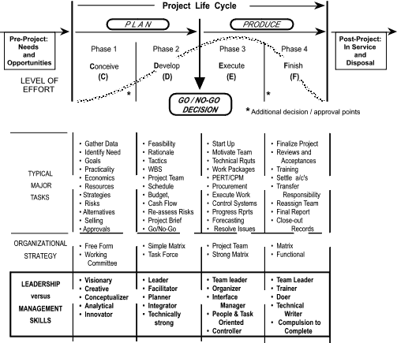
Max Wideman – Project Life Cycle
Figure 2: The Evolution of Tasks and People through the Project Life Cycle

Slide 7
Aspects of Leadership
There are five basic aspects or techniques of leadership
These are:-
  To ensure the co-operation of those being led
  To use authority fairly
  To direct the work, communicating clearly and ensuring that instructions are understood.
  To maintain discipline.
  To develop group morale.

Slide 8
Leadership Pyramid
Time
Respect
Trust
Reliability
Honesty
Commitment

Slide 9
Where does Leadership come from?
Trait Theory
Behavioural Ideals
Situational/Contingency Models
Integrated Approach
  Transformational/ not transactional?
  Distributed leadership?
  Superleaders? Combining trait, behavioural and sitituational/contingency theory

Slide 10
Trait Theory – Stogill list
Strong drive for responsibility
Focus on completing the task
Vigour and persistence in pursuit of goals
Venturesome and originality in problem-solving
Drive to exercise initiative in social settings
Self-confidence
Sense of personal identity
Willingness to accept consequences of decisions and actions
Readiness to absorb interpersonal stress
Willingness to tolerate frustration and delay
Ability to influence the behaviour of others
Capacity to structure social systems to the purpose in hand

Slide 11
Behavioural Ideals – Ohio State/Likert
Consideration – behaviour which demonstrates sensitivity to relationships and social needs of employees
Initiating structure – behaviour which emphasises performance and achievement of product and service goals
The four leadership systems identified;
  Exploitative Autocratic
  Benevolent Authoritative
  Participative
  Democratic
Often referred to as Style Counselling

Slide 12
Situational/Contingency Models

Slide 13
Continuum of Management Styles - Decision Making – Tannenbaum/Schmidt
TELLS
Makes
decision
and announces
it
SELLS
Makes decision
and explains it
CONSULTS
Gets
suggestions
then makes
decision
SHARES
Defines limits
and lets group
make decision
DELEGATES
Allows
individuals to
function within
defined limits
Notes:
RESOURCES Flip chart
Space for pairs discussion
OHP
OHTs 23 and 24
Handouts 16, 17 and 18, 'The Managerial Grid - Assessment',
'The Managerial Grid' and 'Coaching and Managerial Authority'.
APPROACH The extent to which students see coaching as being in
conflict with their own managerial authority will vary. For those
who perceive it as a problem, the approach will need to be a
'selling' approach. For those who do not perceive it as a
problem, the approach will be to confirm this view. Whichever
approach is used, the session should be interactive, and run on
a discussion basis.
Both groups of students will benefit, because the session
also focuses on managerial style and which style is appropriate.
PROCEDURE Outline the session aims.
Divide into pairs and ask students to discuss what conflicts
they may see between coaching and maintaining their
managerial authority, and what conflicts their staff may see.
Allow ten minutes for this.
Re-assemble the group and ask for students' comments.
Note any difficulties on a flip chart.
Page 1 of 3 @ Bernard Redshaw 2000
By questions and discussion, draw out the fact that such conflicts or the lack of them are related to individuals' Management Styles. Certain styles would conflict with the coaching approach. Others would welcome it.
Explain that there are many models available for studying management style and that we are going to examine two of them. Issue Handout 16 (The Managerial Grid - Assessment) and ask each participant to complete it.
Using OHT 23 and the approach followed in Handout 18, explain and discuss the Tannenbaum and Schmidt Model. Draw out that where a manager operates may depend on the situation in which he/she is managing and on how experienced his/her staff are. But usually the desired state is towards the right hand side of the continuum.
Next, using OHT 24 and the approach followed in Handout 17, explain and discuss the Managerial Grid and issue Handout 17. Then check with individuals on how they scored in the assessment questionnaire.
Finally, draw out, by questions and discussion, factors thatmight influence where a good coach would operate on each of the models (note them on a flip chart and discuss each in detail).
Your present management style
The extent of the authority that you have The present capability of the learner The effect on others
Deal with any further discussion and questions. Issue Handout 18.
Page 2 of 3 0 Bernard Redshaw 2000

Slide 14
Exercise
Leadership Styles Questionnaire

Slide 15
Leadership Styles
High
Low Direction
High Support
High Direction
High Support
S2 -Coaching
S3 –
Participating
Increasing Maturity
in role
Low Skill
Increasing Maturity
High Skill
Supportive Behaviour
Low Task
Low Relationships
High Direction
Low Support
S4 –
Delegating
S1 –Directing
High Maturity
High Skill
Low maturity
Low skill
Hersey & Blanchards
(1988)
Low
Directive Behaviour
High
Notes:
Run situational leadership questionnaire
Hersey and Blanchard = Situational leadership
Based on taking on a trainee or someone moving into a new role.
Looks at their level of maturity and also skill or do they know how to do the job and do they want to do the job
Telling = directing
- don’t know how to do the job and/or
- don’t want to do the job
Selling = coaching
- don’t know how to do the job/role
- want to do well at the job
Participating = supporting
- Know how to do the job, may have been doing it for a long time,
- Doesn’t need a lot of hand holding to do the job
Delegating = delegating
- knows how to do the job and
-can do it with minimal input and support from line manager
Look at your leadership style – complete leadership questionnaire and discuss
Which style would you find most difficult to use and why
How can you get better at that style of leadership – work in groups to look at the different styles
Can you think of people who you have managed in the past who would fit into one or more of the boxes?

Slide 16
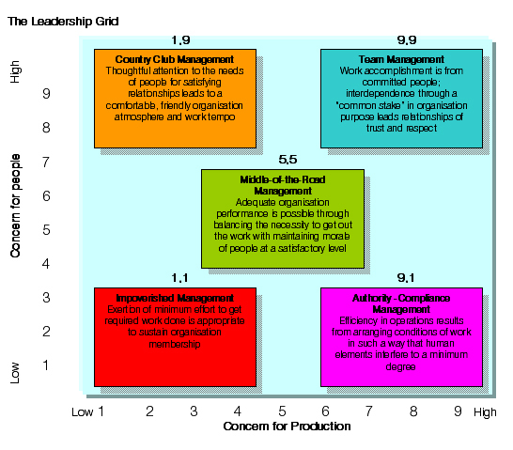
Blake & Moulton – Managerial Style Grid

Slide 17
Management
Or leadership?

Slide 18
A very difficult balance!!
“Control”
“Freedom”
TASKS
PEOPLE
Management
Leadership
Feelings/emotions
Needs
Values
Motivators
Intellect
Process
Rules and regs

Slide 19
Leadership
– addresses ‘Why’ and people
By example
Looks at overall objectives
Inspires
Communicates goal
Vision
Can see outcome
Sets direction
Focus on people
Influences
Motivates
Builds
Shapes rules to make things better
Delegating
Doing right things

Slide 20
Management
– addresses ‘How’ and task
More bureaucratic
Manage objectives
Achieve goals
Motivate people
Here and now
Tasks at hand
Follows policies and procedures
Focus on things
Plan and Organise
Direct
Control
Follow rules
Doing things right

Slide 21
Essential Actions
Communication Empowering
Planning Building trust
Decision making Leading
Problem solving Team building
Motivating Co-ordinting
Delegating Training/coaching
Supporting Facilitating (barriers)
Monitoring Evaluation
Continuously improve Focus on customer needs
Reward and recognise
Notes:
Introduce to PLAN, DIRECT, CONTROL, ACHIEVE
Categorise your list into those 4 groups.

Slide 22
What about you?
How good are you at LEADING your team?
How good are you at MANAGING your team?

Slide 23
Action Centred Leadership
A functional model

Slide 24
John Adair
Task
Team
Individual
Notes:
As a leader these are the 3 interlocking circles that you have responsibility for looking after.
They are interlocked since changing one thing in one are will have a consequence in the other 2 rings.
Consider new actions not only for impact on that one circle but also for the knock on consequences in the other 2.
Look at each in a bit more detail.

Slide 25
John Adair
Task
TASK FUNCTIONS
Defining the task
Making a plan
Allocating work and resources
Controlling quality and tempo of work
Checking the performance against the plan
Adjusting the plan

Slide 26
John Adair
TEAM FUNCTIONS
Setting standards
Maintaining discipline
Building team spirit
Encouraging, motivating, giving a sense of purpose
Appointing sub-leaders
Ensuring communication within the group
Training the group
Team

Slide 27
John Adair
Individual
INDIVIDUAL FUNCTIONS
Attending to personal problems
Praising individuals
Giving status
Recognising and using individual abilities
Training the individual

Slide 28
John Adair
Task
Team
Individual

Slide 29
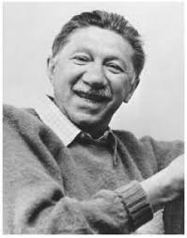
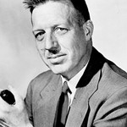
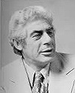
Google images
Notes:
Going to look at some of the great Motivational theorists: Maslow, McGregor and Herzberg
What motivates him?

Slide 30
Maslow Hierarchy of Needs
Fulfilment
Comfort
Esteem
Security
Acceptance
Survival

Slide 31
Maslow’s Hierarchy
Biological needs
Safety needs
Affiliation needs
Esteem needs
Knowing and Understanding
Aesthetics
Trancendence
Freedom of enquiry and expression
Self-actualisation

Slide 32
Douglas McGregor
Theory 'X' and Theory 'Y'
Theory 'X'
  The average man dislikes work and will avoid it whenever possible.
  He must be coerced, controlled, directed and punished.
  He prefers to be directed, avoids responsibility and wants security above all.

Slide 33
Douglas McGregor
Theory 'X' and Theory 'Y‘
Theory 'Y‘
  Work is natural. It may be rewarding or punishing, depending on conditions.
  Man will exercise self direction and control to meet objectives to which he is committed.
  He seeks responsibility; avoidance is a function of experience.
  Creativity to solve problems is widespread, not narrowly distributed in the population.
  Intellectual potential are rarely realised at work.

Slide 34
Fredrick Hertzberg
Motivation Theory
Hygiene Factors
  Pay and benefits
  Company practices
  Man/Boss relationships
  Working conditions
Motivators
  Recognition
  Achievement
  Responsibility
  The work itself
  Advancement
  Potential
Hygiene factors do not provide motivation but
must be satisfied before motivation can be achieved – exit interviews?

Slide 35
Motivation conclusions
  The individual worker is considerably more complex than traditional managers believe.
  Involvement, participation and making sense of the job are important factors.
  The job itself is of prime importance.
  The average worker will work to achieve reasonable targets to which they are committed.
Notes:
From behavioural studies these are the Motivation conclusions we can draw…………….

Slide 36
Motivation conclusions
  The work group is a powerful influence on attitudes and behaviour.
  Working conditions, basic pay and benefits do not motivate, but are necessary prerequisites to motivation.
  Individual cultural or social backgrounds and relative aspirations are important.
Notes:
From behavioural studies these are the Motivation conclusions we can draw…………….

Slide 37
Challenges for the 21st Century Leader
Interconnected and fast developing world
It’s a journey into the unknown
New ways of thinking
Build global strategic partnerships
Motivate and Inspire increasing sophisticated audience

Slide 38
Contribute Uniqueness
There are so many people saying the same thing, how do you stand out?
Have an original perspective that inspires people
Apply knowledge from one area to another or synthesize ideas from different disciplines
Tell a different story about the material; Relate it to your own life and work experiences
Find a novel way to communicate key concepts or approach a problem
Trim the fat off of a theory or operational system; add new elements that improve

Slide 39
Act Effectively
“Efficiency is doing things right; effectiveness is doing the right things.” – Peter Drucker
What are the short and long term challenges that your team/organization will address?
In what way will you contribute unique value in addressing these challenges?
What potential barriers will you face and how will you deal with them?
What skills and resources do you need to optimally provide and support these new services/technologies.
How can your team support people to do their best work and support customers to get the best use out of your products/services

Slide 40
Be Resilient
Everybody makes mistakes. The bigger your goals, the more mistakes you will make.
If you believe in your mission and abilities, failure is just a temporary detour.
Most failures contain one or more lessons. Be willing to admit your contribution to the failure, and be ready to change your thinking about the issue.
Listen to and collaborate with others, but do not suppress your own voice and goals.
Understand that a failure may need to be grieved, allow yourself time to understand and regroup.

Slide 41
Embrace Change
We live in a time of rapid technological, geographical, and economic change.
This creates many challenges, but also opens the door to new opportunities.
The human brain naturally resists change, seeing it as a threat.
Counteract your brain’s natural, fear-based tendencies and cultivate an optimistic attitude to change.
Think about how you can apply your skills and strengths to this changing landscape. What new needs does the change create?
Pay attention to the thoughts and feelings that change brings up in you

Slide 42
Stay grounded
When you do succeed, do not get too distracted by your ego. Success does not make you invincible.
Always keep the meaning of your work at the forefront. Why are you doing what you do?
Practice mindful self-awareness to learn compassion for yourself and others. Much of business is about relationships. If you exude a humble, caring, open attitude, and are a team player, others will be more willing to work with or follow you.
Work hard, but don’t drive yourself like a machine. Life is a marathon, not a sprint
Forming meaningful, trusting relationships with others who have different skills and knowledge, but similar goals and values is the way to succeed

